Slide 1
PREDICTION OF ELECTRICITY CONSUMPTION FOR HOUSEHOLD APPLIANCES. DataLab Certification Project (Team Unique) Supervisors and Markers: Oyeleke Olayemi & Ezinwanne Aka
Presenter: Adamu Nurudeen (DataLab Intern)
https://github.com/Deen360Adamu/DataLabProject

Slide 2
OUTLINE
https://github.com/Deen360Adamu/DataLabProject
Introduction
Data study and Exploratory Analysis
Identification and Trimming of Outliers
Machine Learning Predictive Model
Conclusion

Slide 3
Data study and Exploratory Analysis
Introduction
This project is focused at executing a research into energy conservation and advanced energy services, ranging from non-intrusive appliance load monitoring, demand response measures, tailored energy and retrofit advice, appliance usage analysis, consumption and time-use statistics and smart home/building automation.
Python programming language was utilised for this project.
The data provided was studied carefully for missing values and NAN, and it was found out the data was clean for analysis.
Nine appliances’ (Fridge-Freezer, Washing Machine, Dishwasher, Television Site, Microwave, Toaster, Hi-Fi, Kettle and Overhead Fan) electricity consumption were studies based on time and date against the aggregate load.

Slide 4
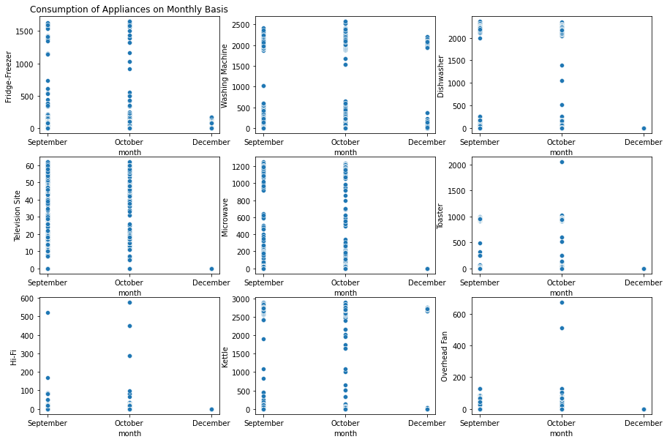
Data study and Exploratory Analysis
CONSUMPTION OF INDIVIDUAL APPLIANCES IN GRAPHS ON MONTHLY BASIS
Fig 1
Observations
In the month of December, owners of the household barely used electrical appliances.
Television Site and Microwave are mostly used but don’t consume as much energy as Washing Machine and Fridge-Freezer.

Slide 5
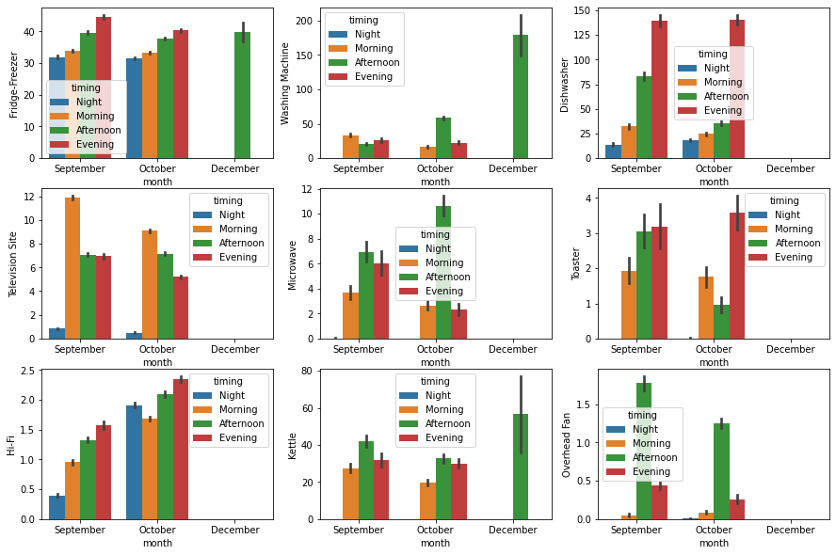
Data study and Exploratory Analysis Cont’d
Fig 2
Observations: After grouping the hours into different period of the day, it can be deduced that
Fridge is mostly ON
Hi-Fi was mostly used in the October than September
Etc

Slide 6
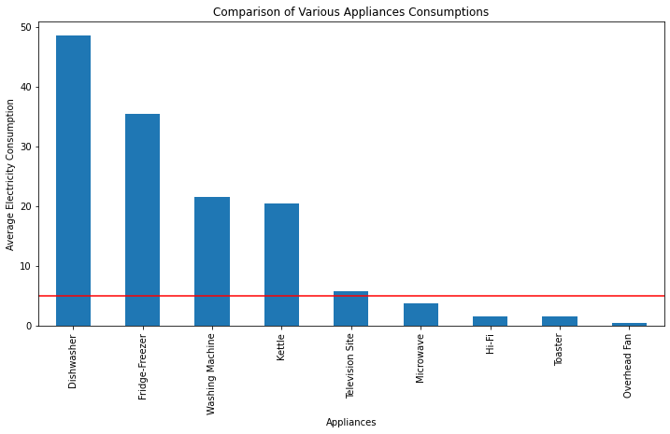
Data study and Exploratory Analysis Cont’d
Fig 3
Observation
On the average, Dishwasher consumed the largest amount of energy while the Overhead Fan consumed the least.
Microwave, Hi-Fi, Toaster and Overhead fan each consumed lower than 5 units of the total energy consumption of the period studied.

Slide 7
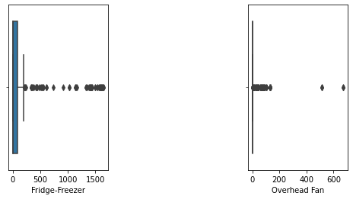
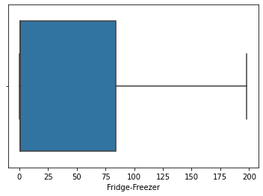
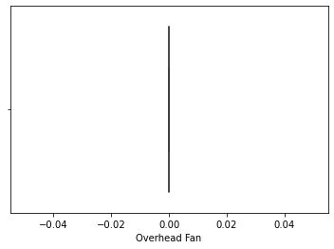
Identification and Trimming of Outliers
Consumption Rate Implementation
An analysis that tells the customer when his/her usage falls under the following categories:
Low,
Medium or
High was carried out using python.
When the usage is below 1800kWh, it is categorised as Low, when the usage is above 4300kWh else it is categorized medium.
Before
Fig 4a
After
Usage
Low: 461842 instances
Medium 21892 instances
High : 3517 instances
Fig 4B
Technically: The unusual afternoon activities recorded in fig2. in the month of December can be attributed and classified as outliers.
Else, the house owner probably stays in the house only in the afternoon in December.
https://github.com/Deen360Adamu/DataLabProject

Slide 8
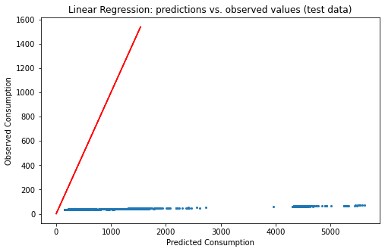
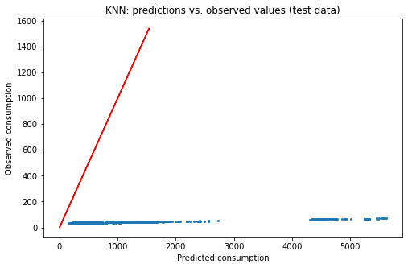

$r^{2} score values comparison$
Fig 5
Linear Regression
Test r2 score: -0.69 (69%)
Test RMSE: 567.08
K-Nearest Neighbours Model
Test r2 score: -0.6899(68.9%)
Test RMSE: 567.14
Decision Tree Model
Test r2 score: -0.707(70.7%)
Test RMSE: 563.90
Random Forest Model
Test r2 score: -0.707(70.7%)
Test RMSE: 563.86
XGBOOST Model
Test r2 score: -0.689(68.9%)
Test RMSE: 567.17
From these models, Random Forest was able to attain the highest r2 of 70.7%.
The negative r2 in all models indicates that the chosen model fits worse than a horizontal line.

Slide 9
https://github.com/Deen360Adamu/DataLabProject
CONCLUSIONS
The occupants of the house used as case study are constant consumers of electricity.
Except for the month of December, there is always an appliance in use at all time of the day; morning, afternoon, evening and night.
Appliances consume different amount of energy, thus being the most used appliance does not translate being the highest energy consuming appliance.
Data analysis has proven to be a very helpful tool in giving a picture of how electricity is consumed and able to provide very valid predictions of future usage via modelling.

Slide 10
THANK YOU FOR LISTENING

